Slide 1
CS213 – 2022 / 2023
Programming II
Lecture 8: OOP – VI
Object Arrays and OOP Modeling
Cairo University, Faculty of Computers and AI
By
Dr. Mohammad El-Ramly

Slide 2
Lecture Objectives
Arrays of Objects
OOP Modeling Example

Slide 3
1. Arrays of Objects
Objects can be the elements of an array:
  InventoryItem inventory[40];
Default constructor for object is used when array is defined

Slide 4
Arrays of Objects
Must use initializer list to invoke constructor that takes arguments:
  InventoryItem inventory[3] =
  {"Hammer", "Wrench", "Pliers"};

Slide 5

Arrays of Objects
If the constructor requires more than one argument, the initializer must take the form of a function call:

Slide 6

Arrays of Objects
It isn't necessary to call the same constructor for each object in an array:

Slide 7
Accessing Objects in an Array
Objects in an array are referenced using subscripts
Member functions are referenced using dot notation:
  inventory[2].setUnits(30);
  cout << inventory[2].getUnits();

Slide 8
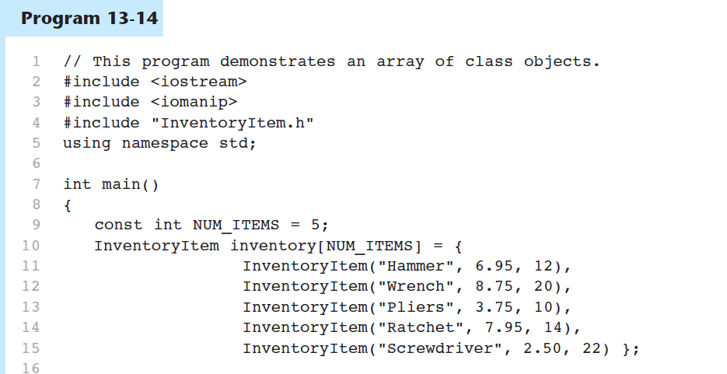

Slide 9
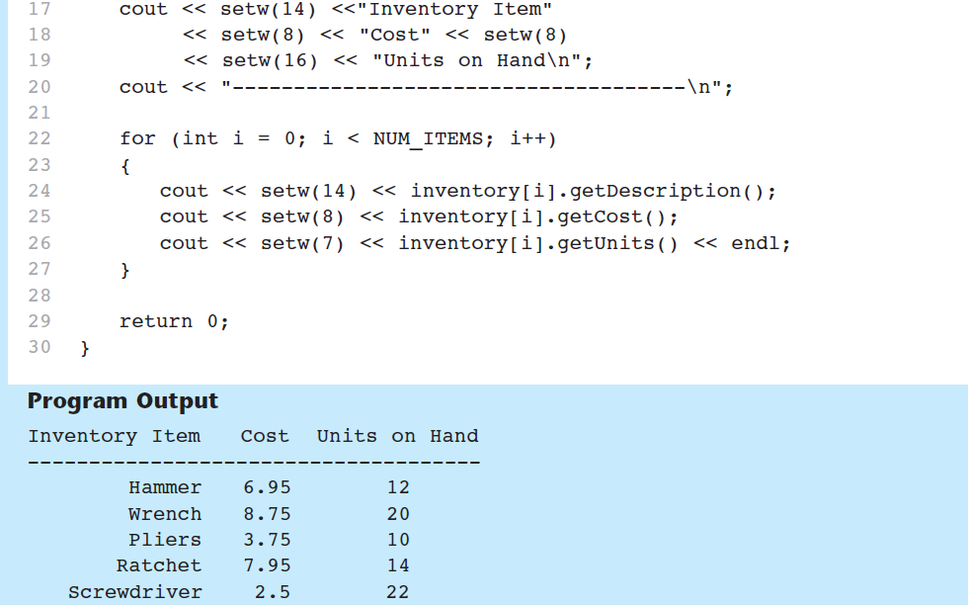
Program 13-14 (Continued)

Slide 11
Dynamic Arrays of Objects
Like any other type, you can make a pointer that points to a single object or an array of objects (dynamically allocated with new operators)
You need to use delete or delete [] in the destructor
  Animal* an_animal = new Cat();
  Cat* cats = new Cat[3];

Slide 12
Five ways to create dynamic arrays of objects.
Using new operator
Using malloc()
Using an array of pointers
Using a pointer to pointers
Using vector<T>

Slide 13
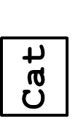
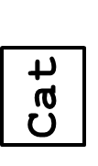
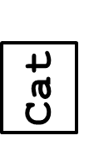
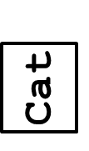
1. Using new operator
  // Array of dynamic objects of
  // equal size and default constructor
  Animal* animals = new animals[5];
  for (int i = 0; i < 5; i++)
  animals[i].eat();
  for (int i = 0; i < 5; i++)
  (animals + i) -> eat();
  delete[] animals;
animals
☻

Slide 14
What is the problem with this code?
// drink exists in Cat and not
// in Animal
Animal* cats = new Cat[2];
cats[1].drink();
// Animal pointer sees only
// parts of Animal in Cat

Slide 15
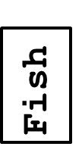
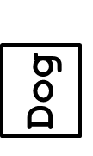
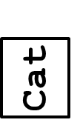
2. Using malloc()
  // Allocate a block of memory
  // Can call parameterized constructors
  Animal* a = (Animal*) malloc
  (sizeof(Animal) * 3);
  a[0] = Animal("Cat");
  a[1] = Animal("Dog");
  a[2] = Animal("Fish");

Slide 16
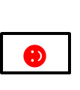

3. Using an array of pointers
  // Array of pointers to parent. Each
  // pointer points to any type of child
  Animal* animals[] =
  {new Animal("animal"),
  new Cat("cat"),
  new Dog("dog")};
  for (int i = 0; i < 3; i++)
  animals[i] -> eat();
  for (int i = 0; i < 3; i++)
  delete animals[i];
animals
☻
Animal
Cat
Dog

Slide 17
4. Using a pointer to pointers
  // Pointer to pointers to parent. Each
  // pointer points to any type of child
  Animal** animals = new Animal*[3];
  animals[0] = new Animal("animal");
  animals[1] = new Cat("cat");
  animals[2] = new Dog("dog");
  for (int i = 0; i < 3; i++)
  animals[i] -> eat();
  for (int i = 0; i < 3; i++)
  delete animals[i];
animals
☻
Animal
Cat
Dog

Slide 18
5. Using vector<T>
  // Using vector in STL
  vector<Animal> v; // Do not do vector<A> v(3)
  v.reserve(3);
  v.push_back(Animal("animal"));
  v.push_back(Cat("cat"));
  v.push_back(Dog("dog"));
  // Same problem as new
  // Will see only animal part

Slide 20
2. The Unified Modeling Language

Slide 21
The Unified Modeling Language
UML stands for Unified Modeling Language.
The UML provides a set of standard diagrams for graphically depicting object-oriented systems

Slide 22
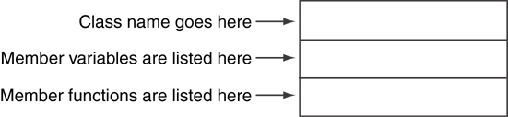
UML Class Diagram
A UML diagram for a class has three main sections.

Slide 23
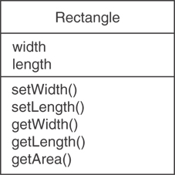
Example: A Rectangle Class
class Rectangle
{
private:
double width;
double length;
public:
bool setWidth(double);
bool setLength(double);
double getWidth() const;
double getLength() const;
double getArea() const;
};

Slide 24
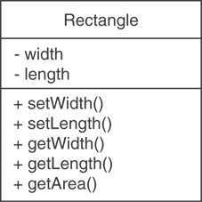
UML Access Specification Notation
In UML you indicate a private member with a minus (-) and a public member with a plus(+).
These member variables are private.
These member functions are public.

Slide 25
UML Data Type Notation
To indicate the data type of a member variable, place a colon followed by the name of the data type after the name of the variable.
- width : double
- length : double

Slide 26
UML Parameter Type Notation
To indicate the data type of a function’s parameter variable, place a colon followed by the name of the data type after the name of the variable.
+ setWidth(w : double)

Slide 27
UML Function Return Type Notation
To indicate the data type of a function’s return value, place a colon followed by the name of the data type after the function’s parameter list.
+ setWidth(w : double) : void

Slide 28
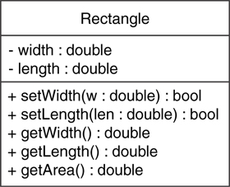
The Rectangle Class

Slide 29
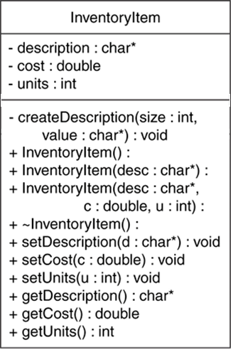
Showing Constructors and Destructors
No return type listed for constructors or destructors
Constructors
Destructor

Slide 30
Relations between Classes
Point
Association
Inheritance
Square

Slide 31
Multiplicity of Association
Multiplicity
4
Point
Square

Slide 32
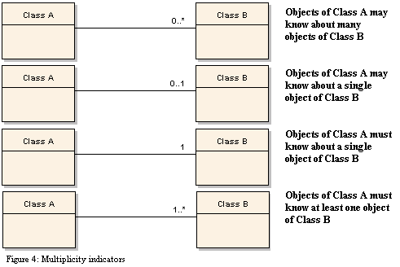
Multiplicity of Association

Slide 33
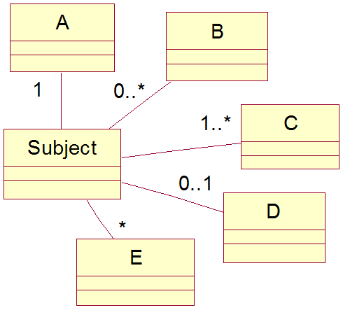
Relations between Classes

Slide 34
OOP Modeling Example
Library System
We like to build a library system
Library has books, each has an id, title & author.
There are regular books and rare books. Rare books مخطوطات و كتب نادرة cannot be borrowed.
There are 2 types of users: Student & Professor. Depending on his type, he is allowed a max number of books to borrow: 2 for student & 4 for professors. A professor can borrow for 4 weeks and a student for 2 weeks.

Slide 35
OOP Modeling Example
Library System
A user is identified by his name and phone.
At start, library data loads existing books and users from files.
The system allows adding a new book or a new user, listing all books or all users, giving a book to a user to borrow or returning it.
At closing, the system stores books and users.
Develop a model for this system using OOP and build it.

Slide 36
https://www.geeksforgeeks.org/copy-constructor-in-cpp/

